Slide 1



Enhanced Traffic Sign Recognition System
Group 7
Sunil Yanagandula(U82205360)
Kumara Swamy Padigeri(U45008503)

Slide 2

Overview
Problem statement
Data Preparation
Model Architecture
Training Process
Results
Conclusion

Slide 3


Problem statement
Enhancing the safety aspects of driverless vehicles and advanced driver assistance systems requires accurate traffic sign recognition. Accurate sign detection in changeable settings, like poor light and impediments, is a challenge for current technology. The goal of this project is to provide safer and more dependable navigation in a variety of driving scenarios by proposing a method to greatly increase the accuracy and resilience of traffic sign recognition utilizing autoencoders and convolutional neural networks (CNNs).

Slide 4

Description of Dataset
Data Preparation
Data Preprocessing

Slide 5
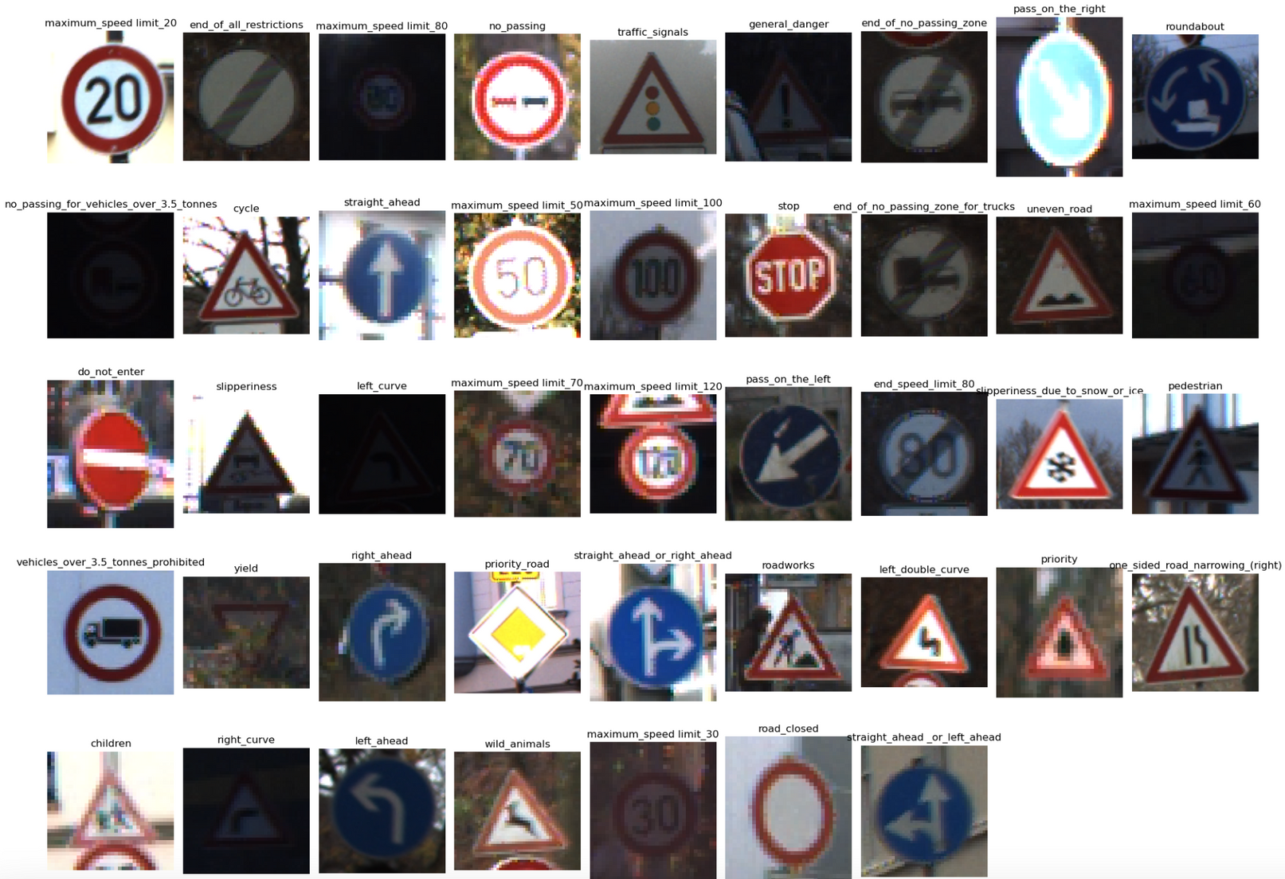

Slide 6
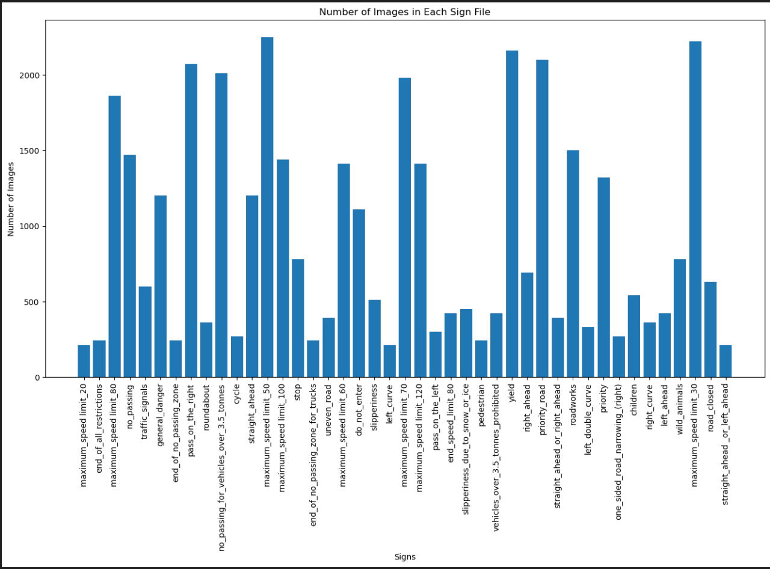

Slide 7
Image Resizing
Every image was scaled to a standard 32 by 32 pixel size.
Data Preprocessing
Normalization
Pixel values were normalized to a range of 0 to 1 in order to help the neural network train more quickly.
Data Splitting
The final dataset was split as 80% and 20% for the training and validation sets, respectively.

Slide 8
Autoencoder Architecture
Model Architecture
Convolution Neural Network
Architecture

Slide 9
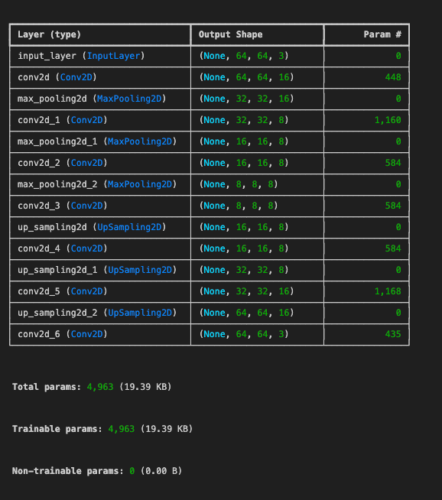

Slide 10

Autoencoders
Autoencoders can be especially useful in this application, as they can pick up accurate representations of traffic signs even in the face of changing lighting, occlusions, or weather, Through the process of autoencoder training, the model we expect that the model will be able to identify key characteristics that are less vulnerable to perturbations in the surrounding environment while reconstructing the sign images.
Training Process
Convolutional Neural Networks
CNNs perform exceptionally well in image recognition tasks as they can extract spatial features from image input. In this project, the extracted features from the autoencoder will be classified into the appropriate traffic sign categories using a CNN.

Slide 11
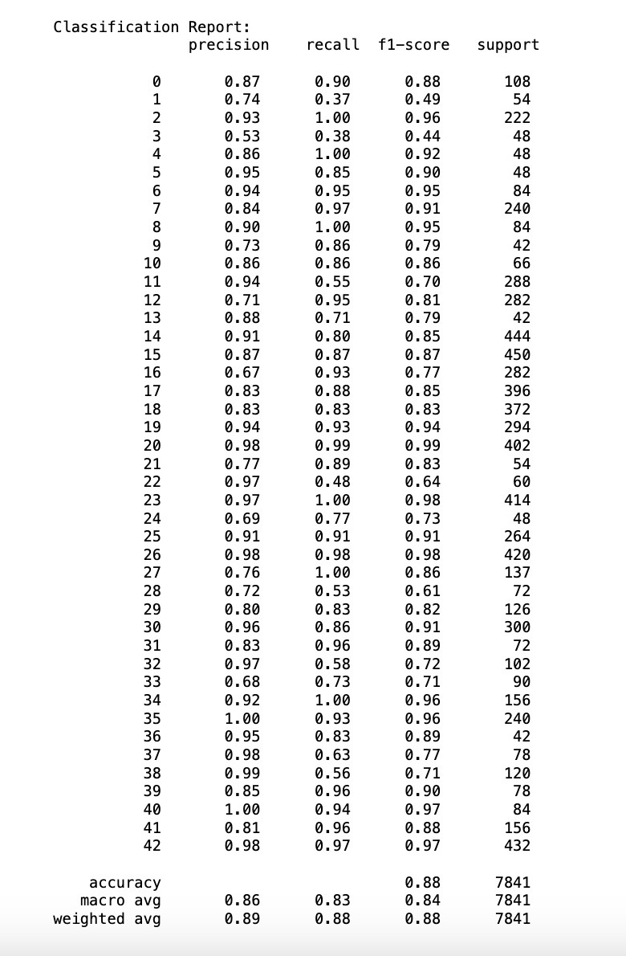
Results

Slide 12
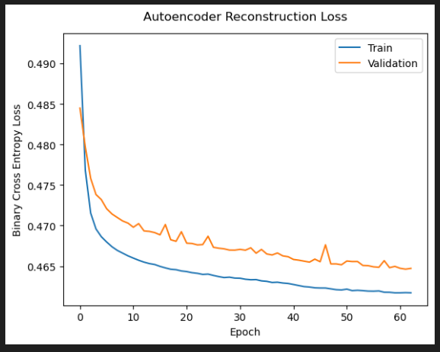
Autoencoder Training and Validation Loss Curve:

Slide 13
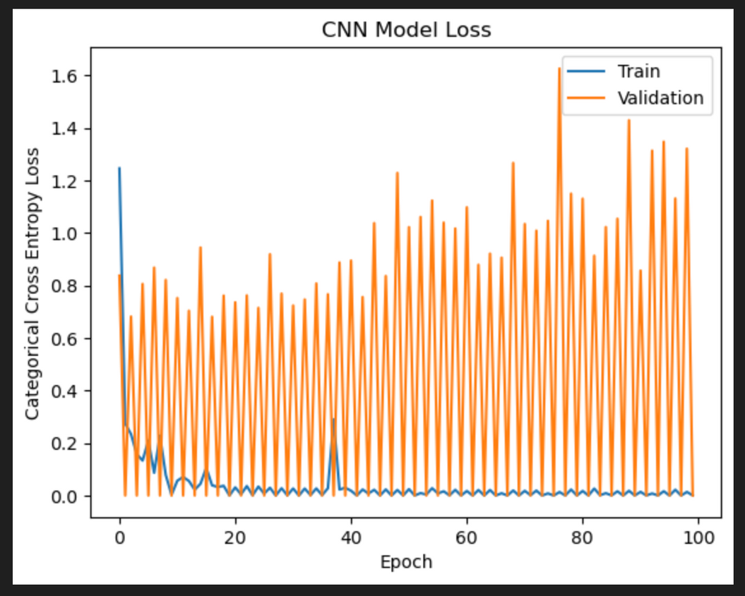
CNN Training and Validation Loss Curve:
The model's performance stabilized around epoch 20, as there is minimal improvement in both validation loss and validation accuracy beyond this point.

Slide 14
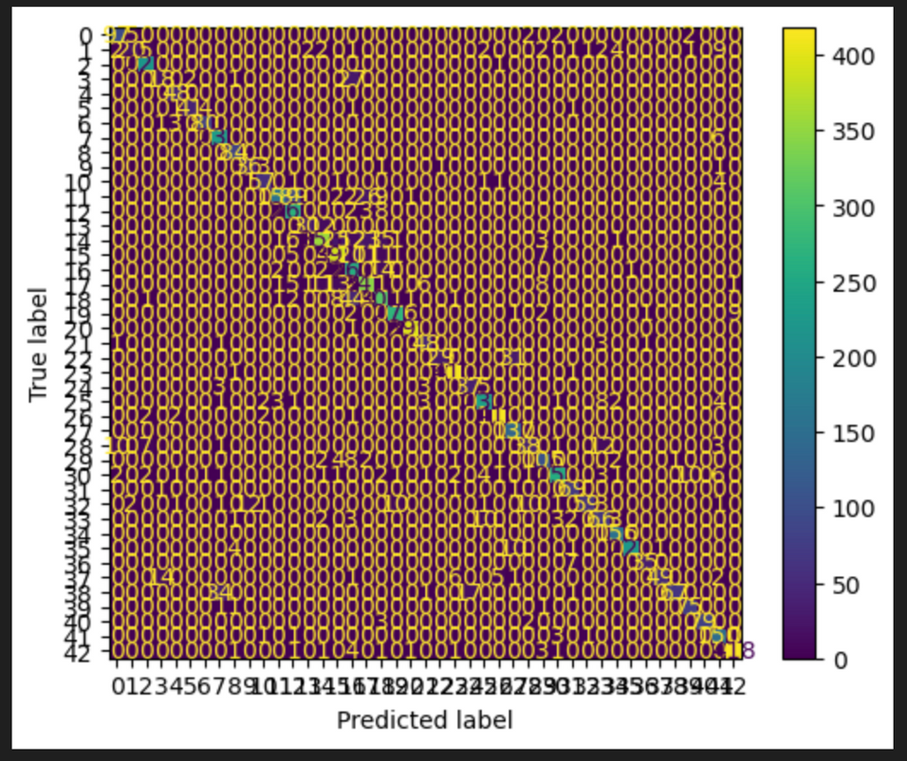
Confusion Matrix

Slide 15
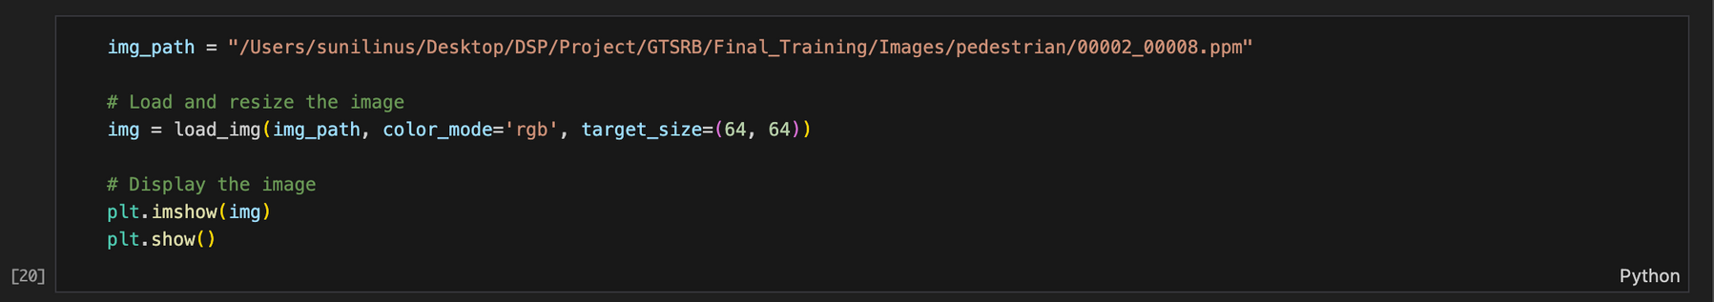
Sample Prediction

Slide 16
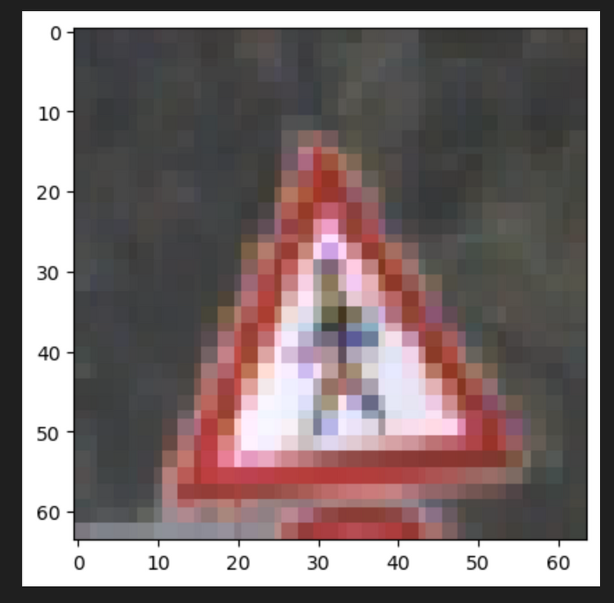
Sample Prediction

Slide 17
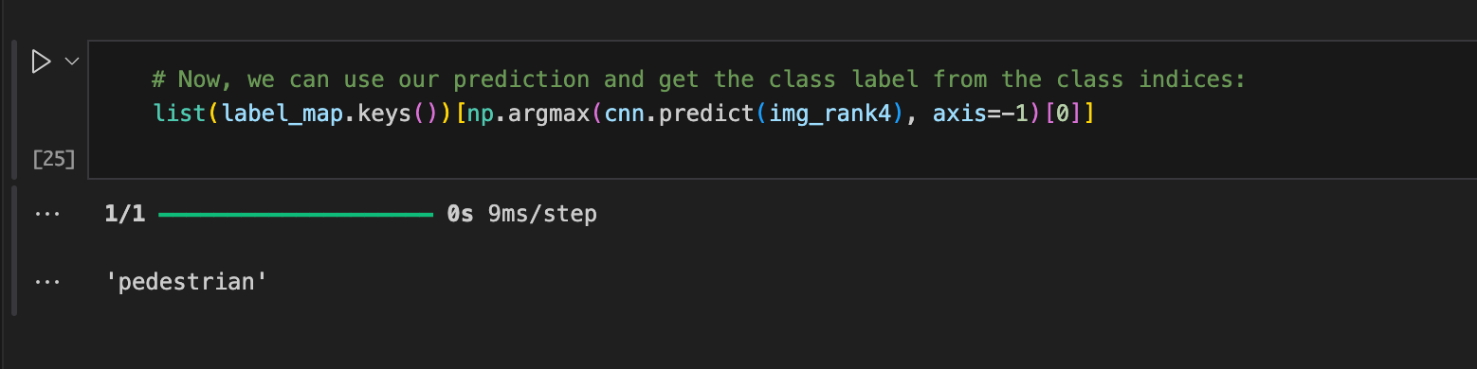
Sample Prediction

Slide 18


Conclusion
01
02
03
Acheivements
Implications
Future Work
Accuracy: 88.00%
Effective Feature Extraction
Advanced Classifications with CNN
Enhanced Road Safety
Scalability and Adaptability
Potential for Real-World Application
Dataset Expansion
Exploration of New Architectures
Integration with Other Systems

Slide 19

For watching this presentation

